Slide 1
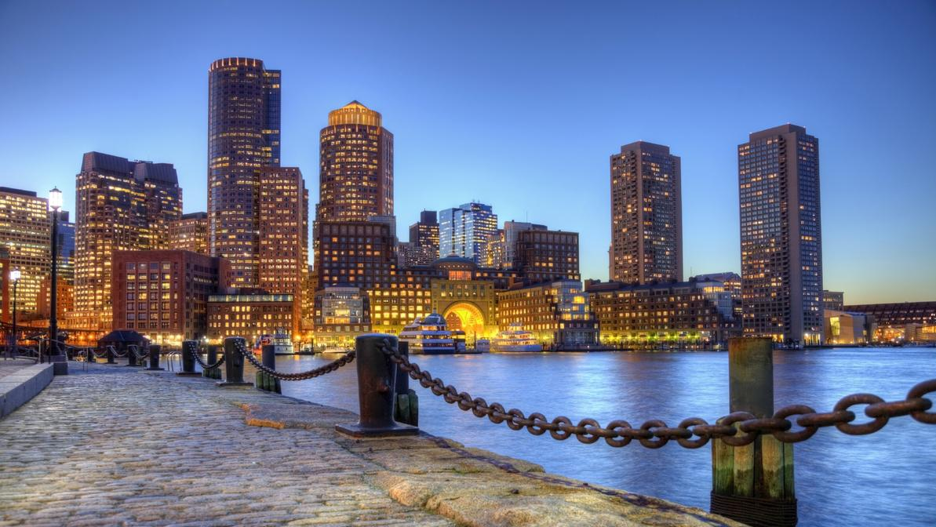
Bring Your Own Water
Day 2 - Diving Deeper into the Marine Microbiome

Slide 2
Objectives
1. Predict how environmental conditions (presence of nutrients, temperature, pH, etc.) impact a marine ecosystem and the organisms it harbors
2. Develop testable hypotheses, as well as design experiments capable of garnering data which address these hypotheses
3. Visualize data in a meaningful, concise, and informative way
4. Present scientific data to a general audience in a compelling manner
5. Speculate future research questions based on preliminary inquiries

Slide 3
Guiding Questions
1. What techniques are used to visualize marine microbes? Are these methods comprehensive, and if not, how can these microbes be accounted for?
2. What are common methods for microbiome monitoring? Are these monitoring methods identical across different environments (soil, water, gut)?
3. How does interest in or question about the marine microbiome turn into a testable hypothesis?
4. How do you decide on the proper scope and parameters of an experiment (sample size, replicates, time points, dilutions)?
5. How do you visualize experimental results in a way that highlights the key information learned through the experiment?

Slide 4
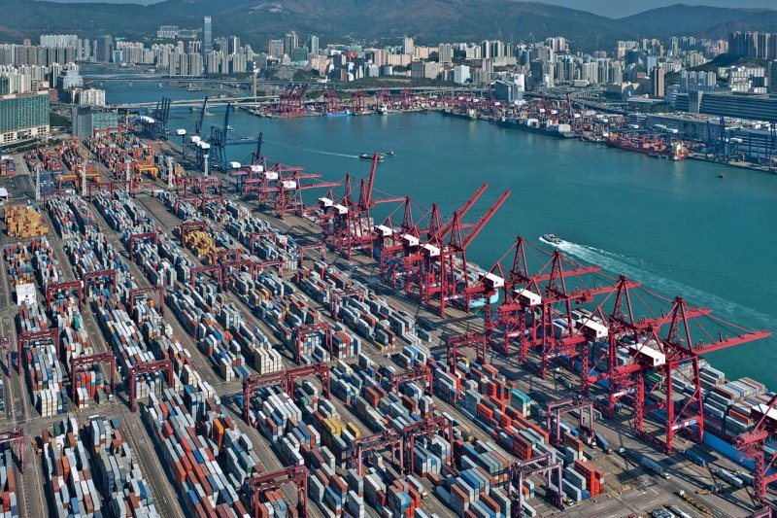
Concept Review
What is ecology?
What makes up an ecosystem?
What scales are relevant to an ecosystem?

Slide 5
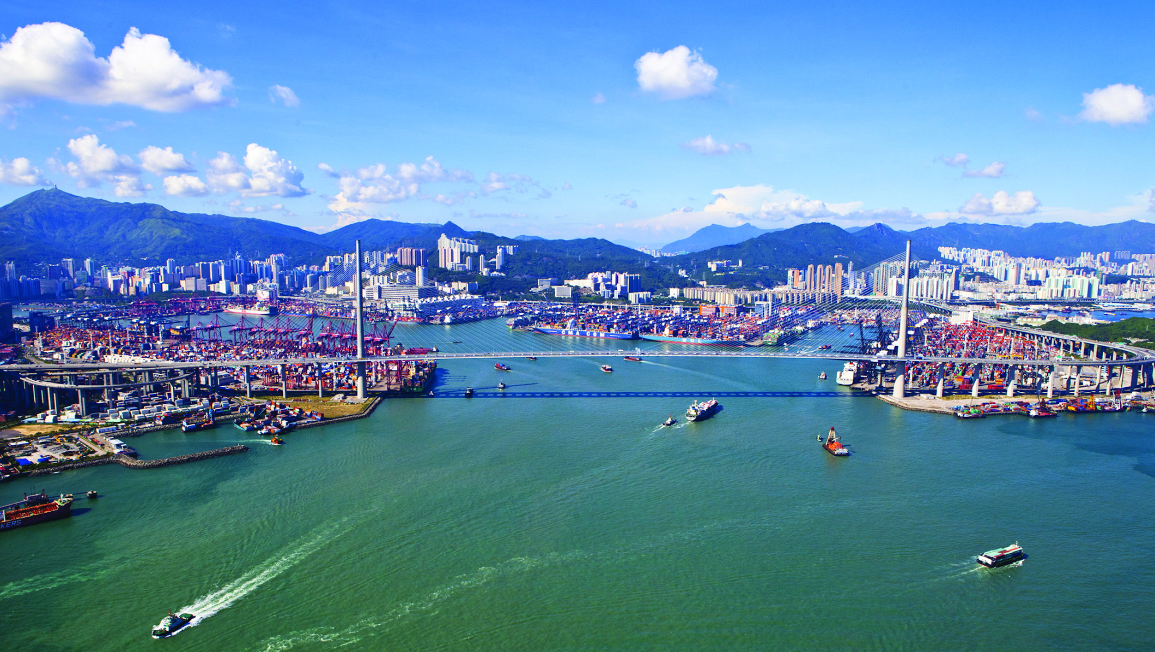
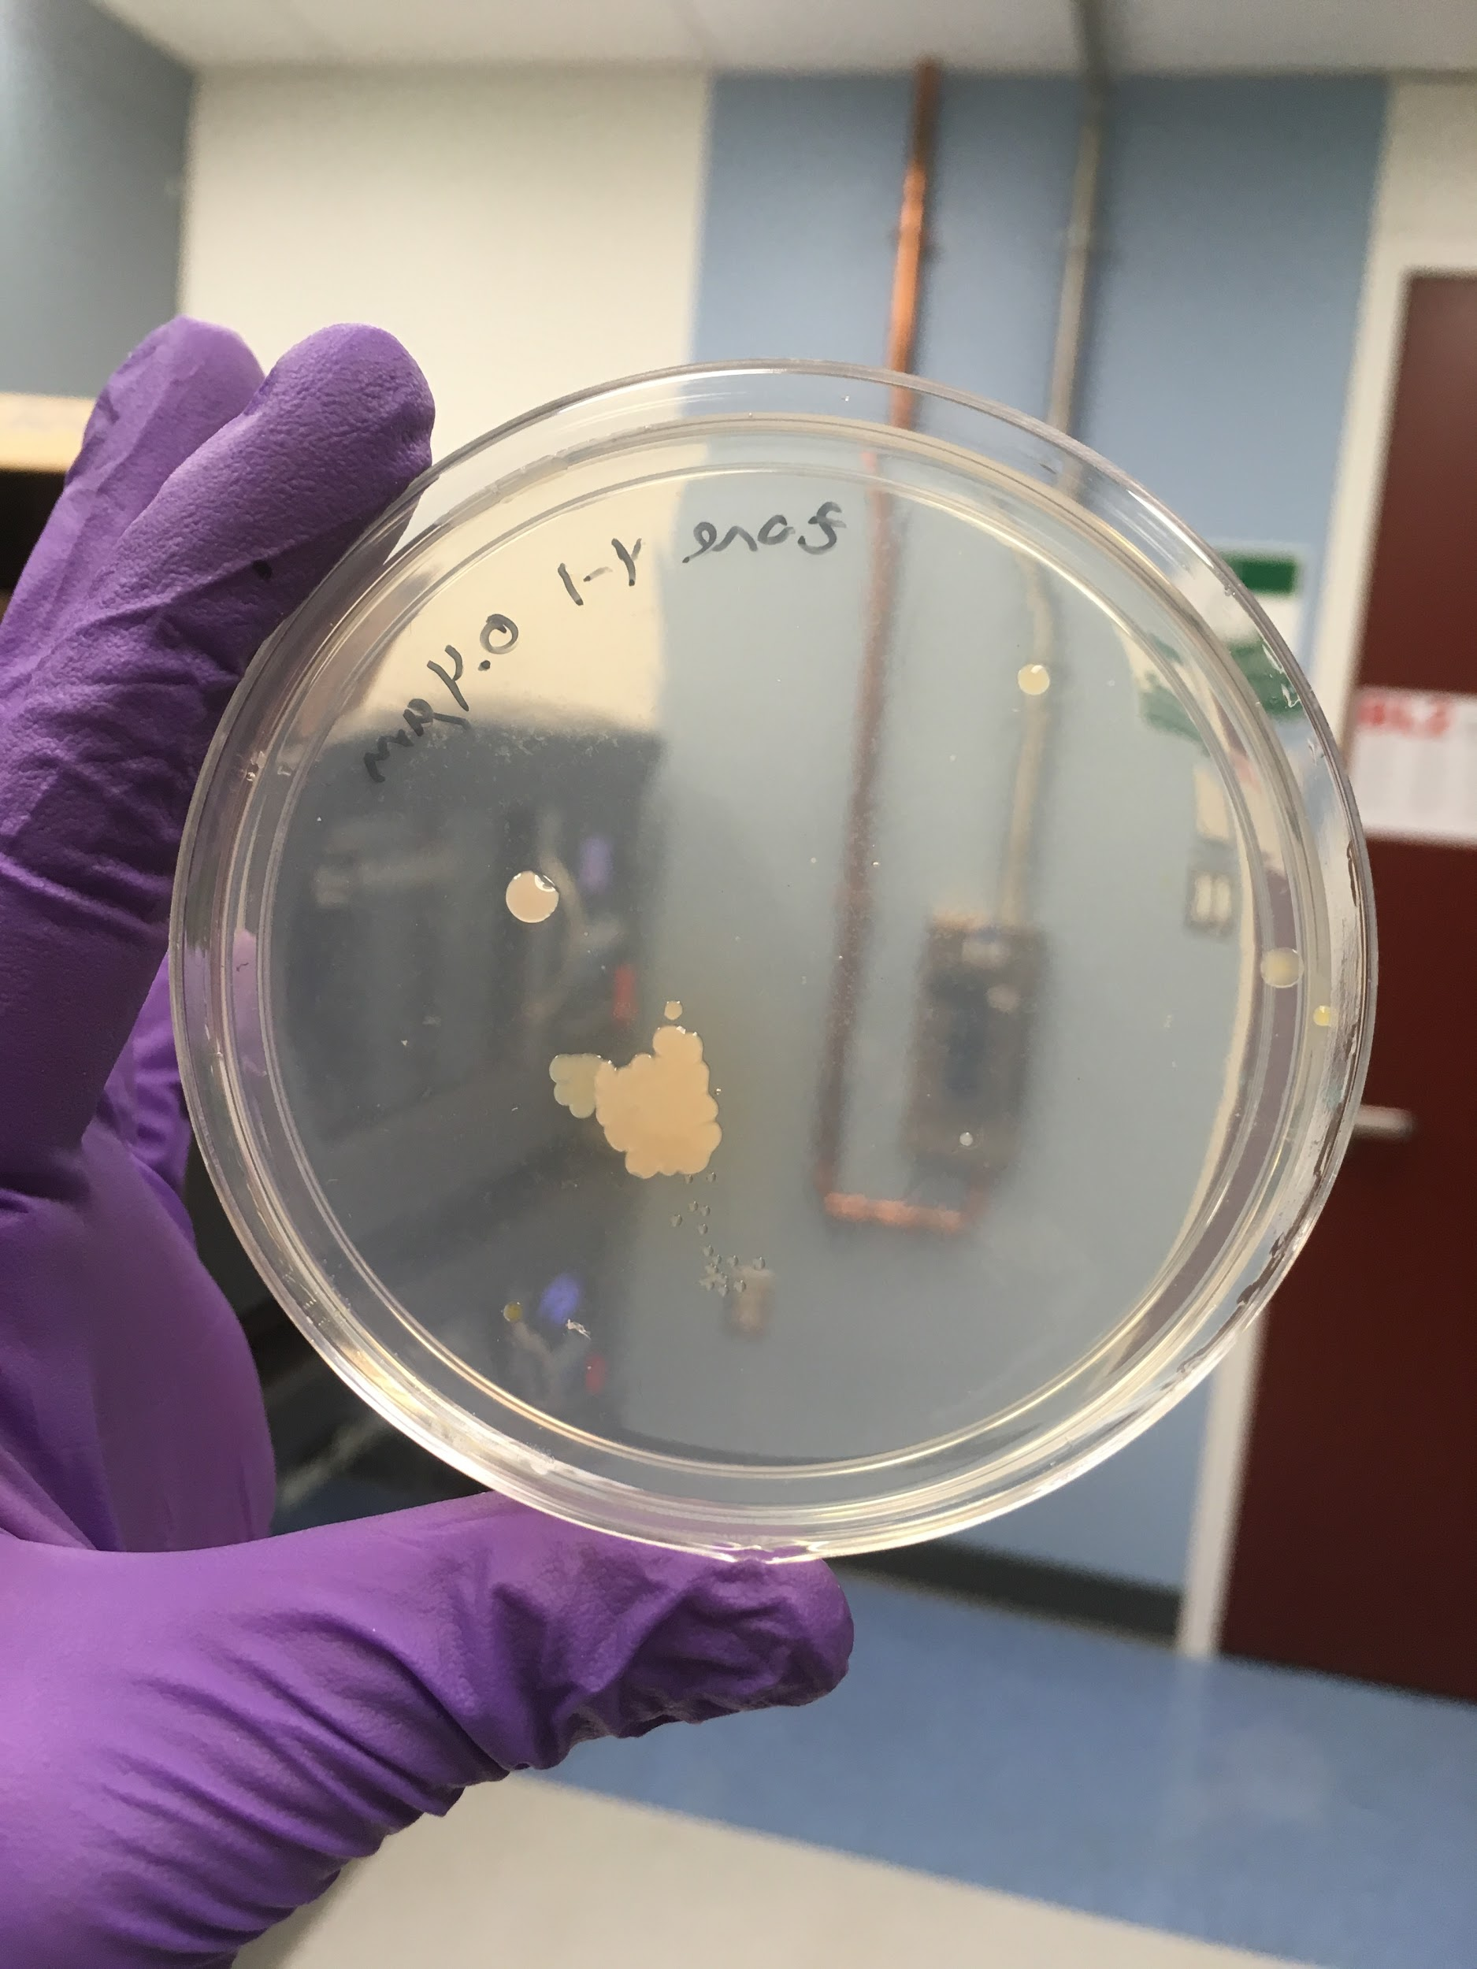
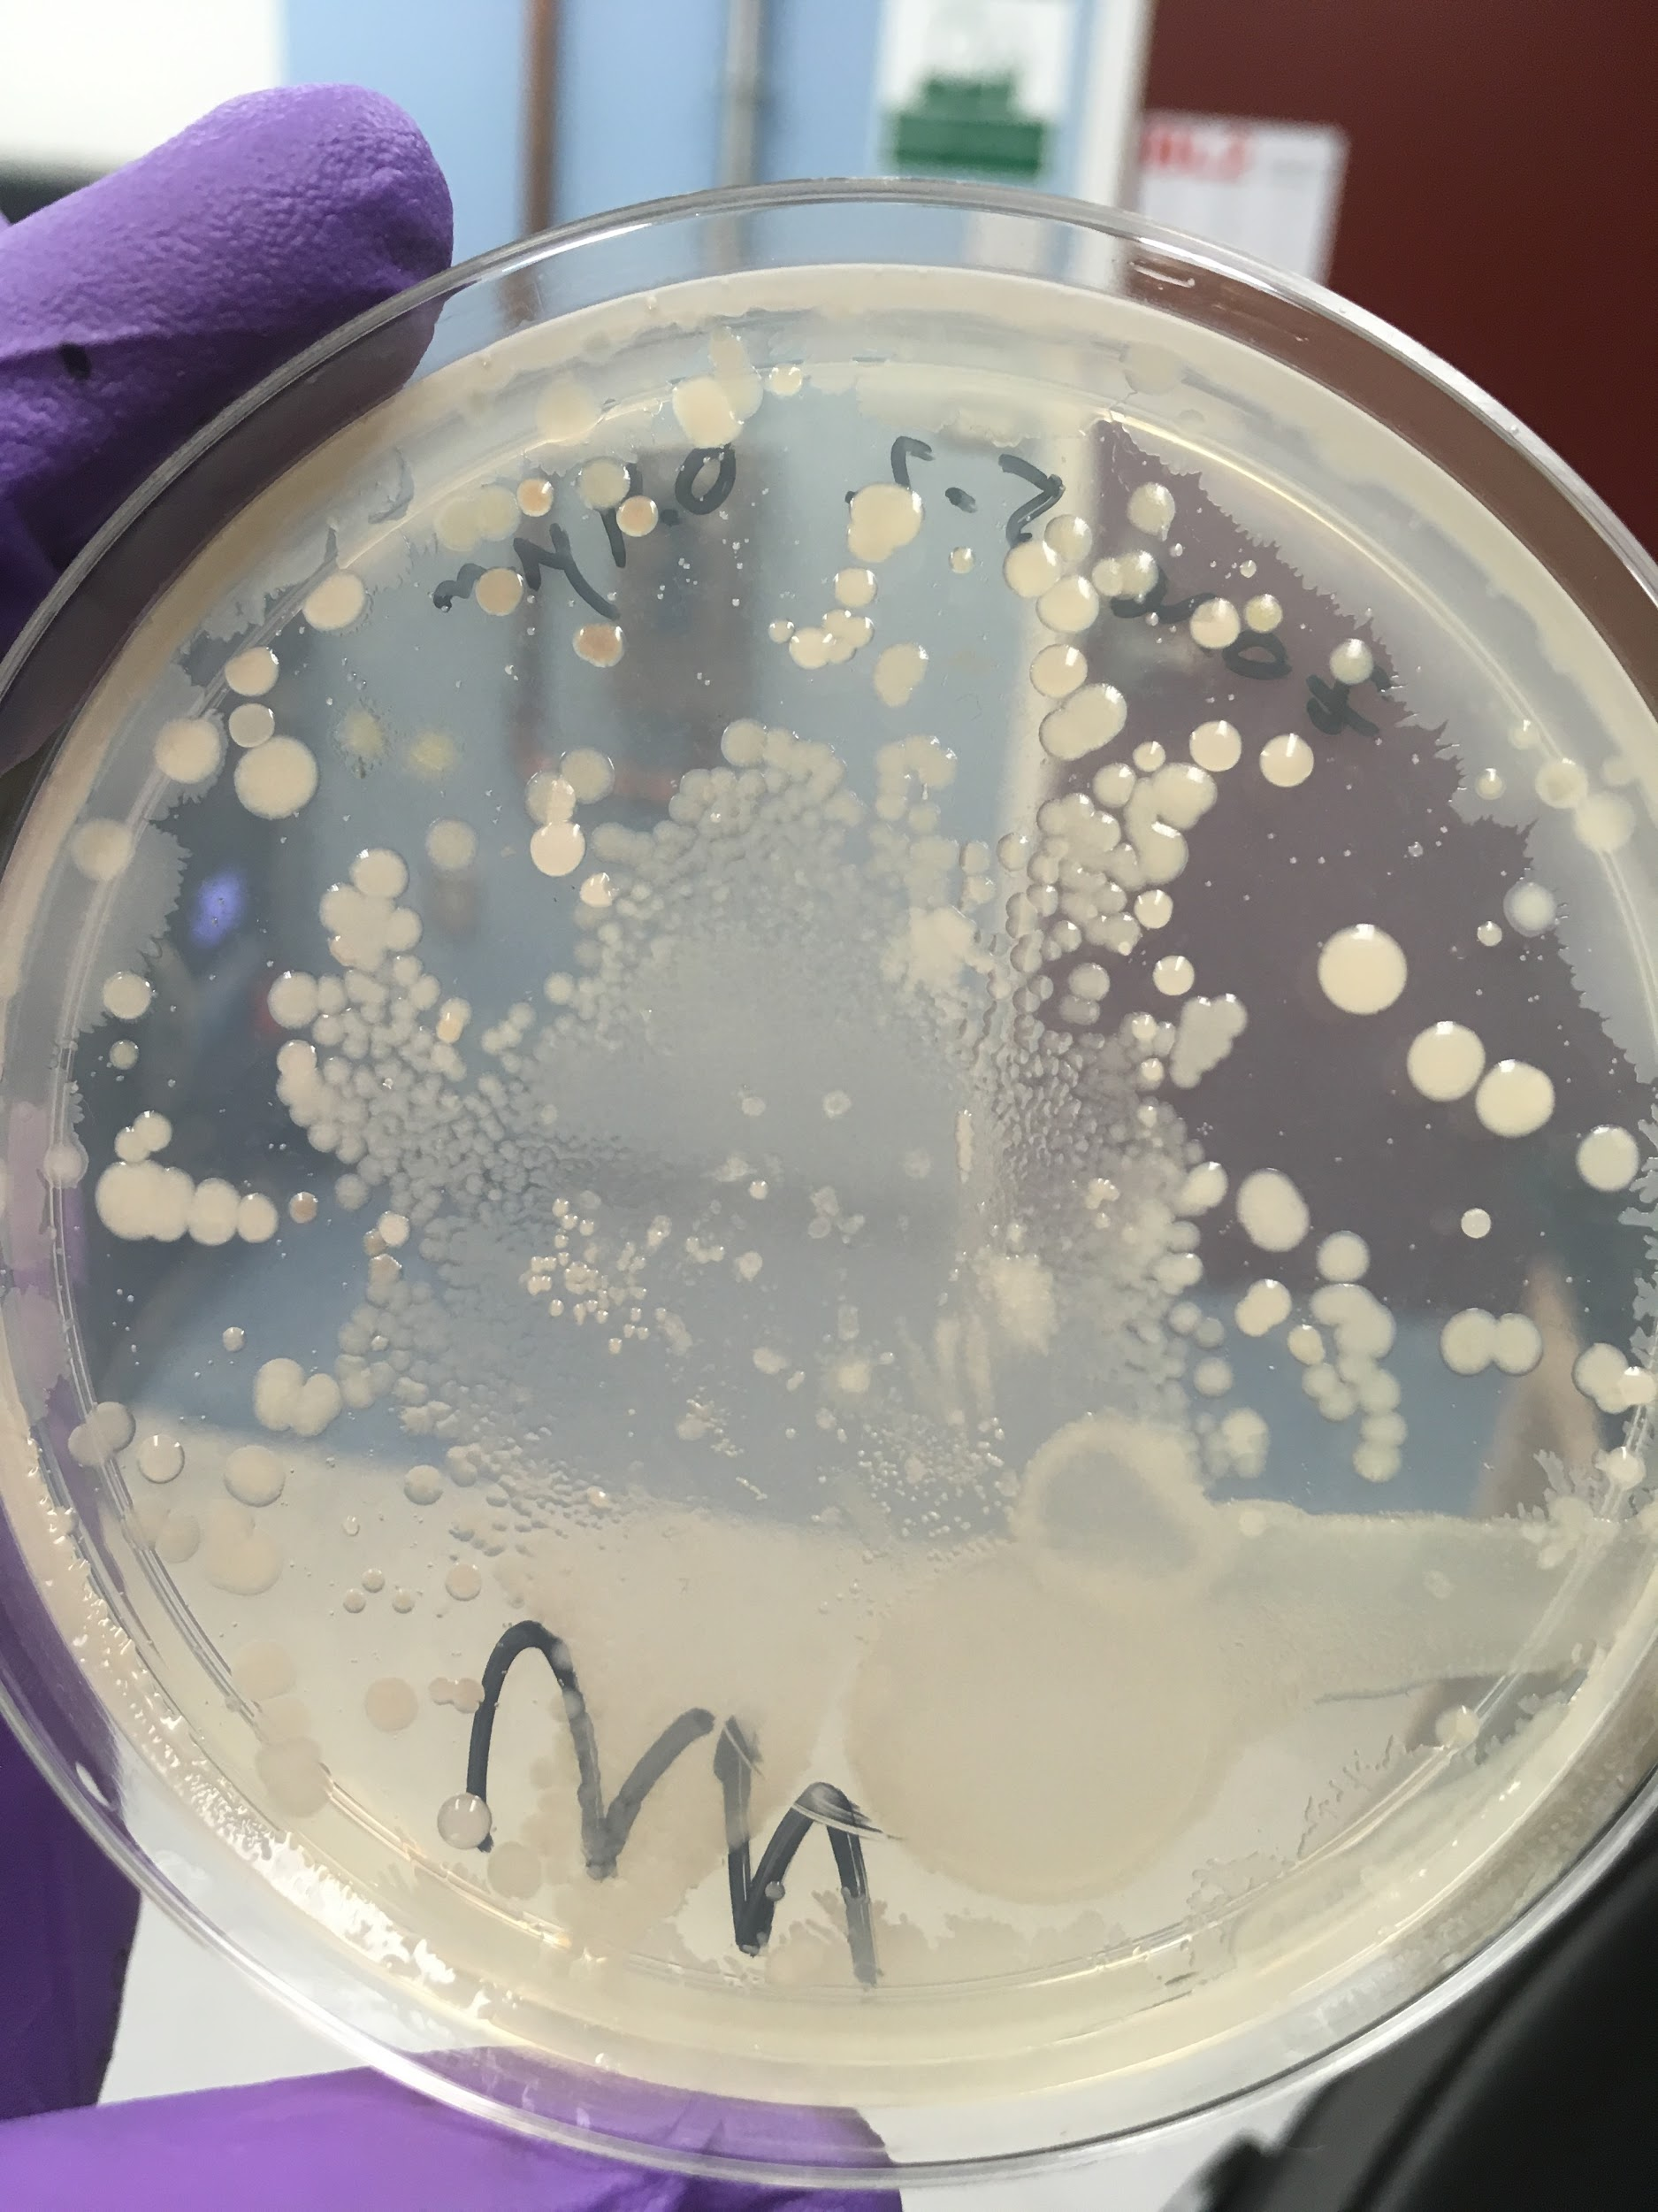
Culturing Marine Microbes
Notes:
Basically, you are trying to re-create the environment that the microbes came from in order to have an environment suitable for the microbes to be grown in.

Slide 6
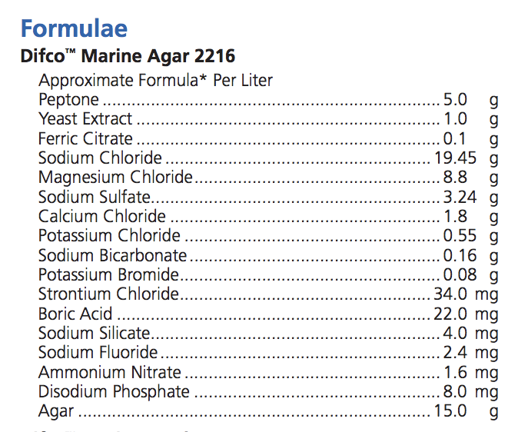
Marine Agar Ingredients
amino acids, peptides, water soluble vitamins and carbohydrates and can be used as additive for culture media
Salts and chemical compounds to mimic the ocean environment
Notes:
Basically, you are trying to re-create the environment that the microbes came from in order to have an environment suitable for the microbes to be grown in.

Slide 7
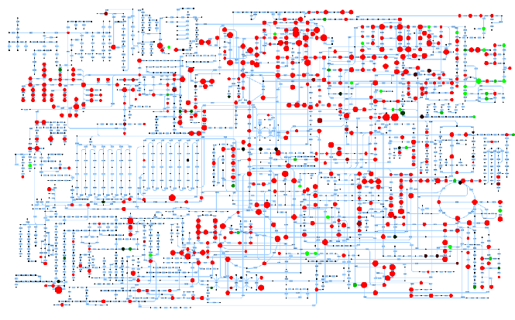
Metabolomics
Where do microbes get their nutrients in their native environment?
What temperature does this organism usually function at?
Are there any chemical processes that a microbe might rely on another organism to perform for them?
What genes are present in the genome, and how does that give us insight into their daily lives?

Slide 8
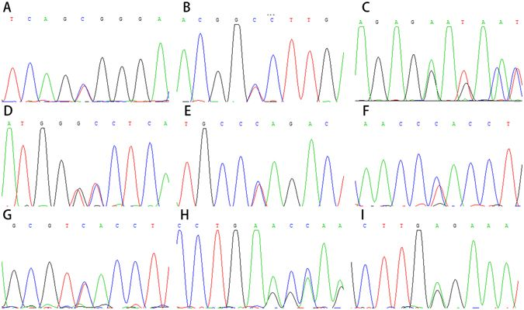
How do we probe the unculturable?
DNA Sequencing technology has vastly improved our ability to understand the multitude of microbes present, because we do not need to culture the sample to get results!
This technique has opened the eyes of scientists how much more vast the microbial world is than we could ever imagine!
Notes:
We can SEQUENCE !

Slide 9
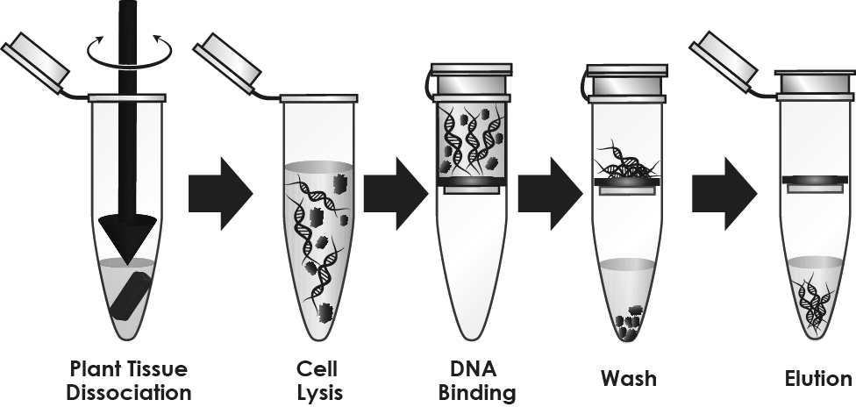
DNA Extraction

Slide 10
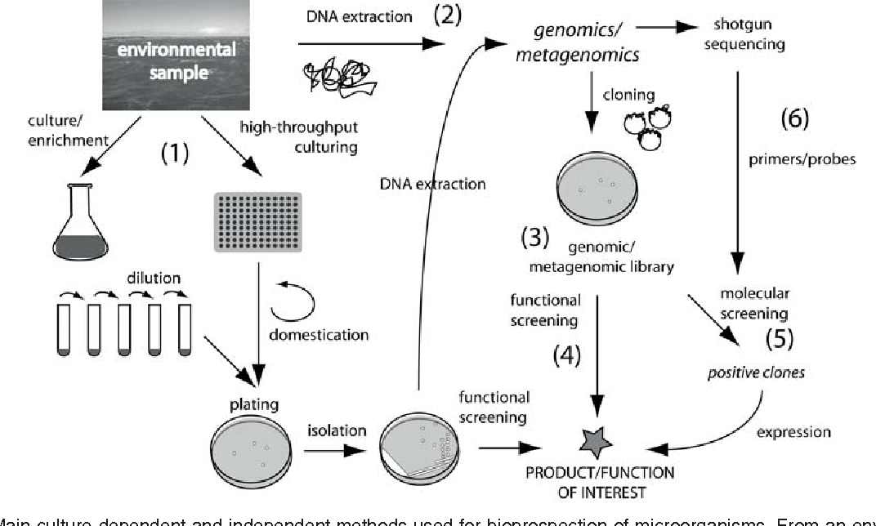
An example workflow
Dionisi, Hebe M., Mariana Lozada, and Nelda L. Olivera. "Bioprospection of marine microorganisms: biotechnological applications and methods." Revista argentina de microbiología44.1 (2012): 49-60.

Slide 11
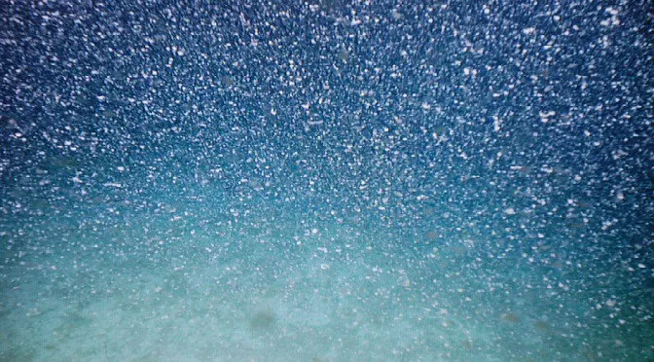
Macroscopic Particles in Marine Environments

Slide 12
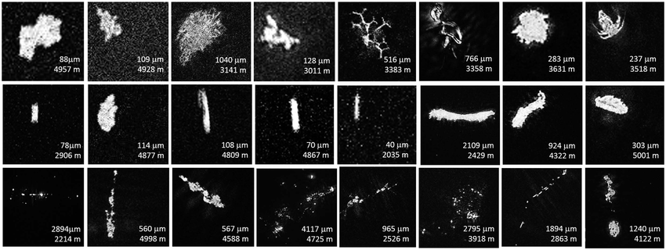
What is considered at the “macroscopic” scale?
Macroscopic particles are anything that can be seen with the naked eye (no magnification!)
It’s usually anything found in the ocean that is 1mm or larger

Slide 13
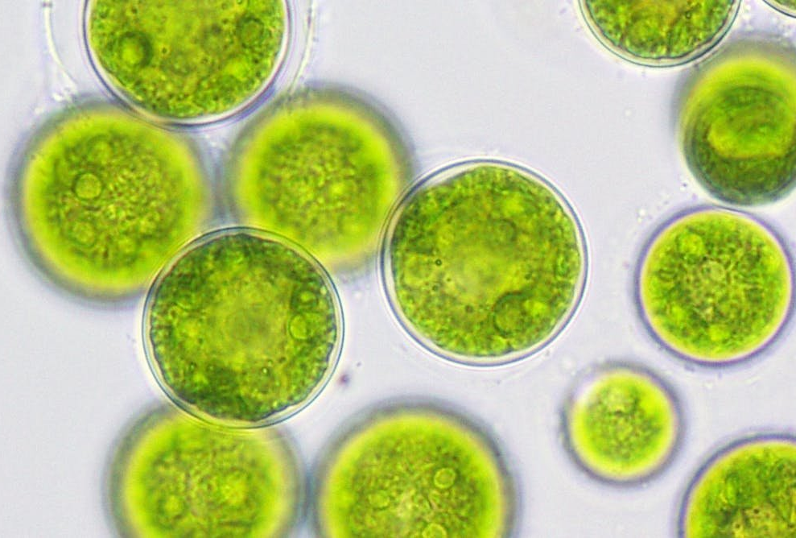
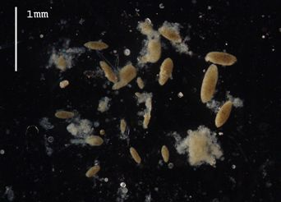
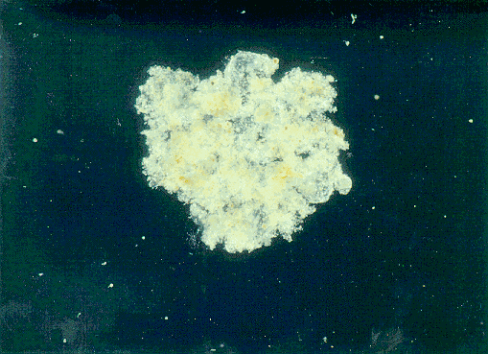
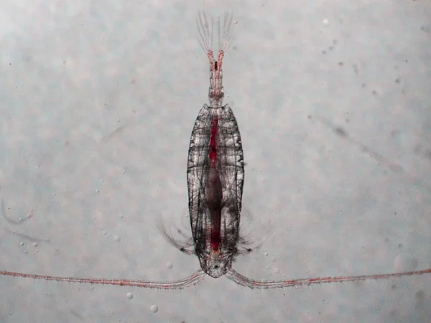
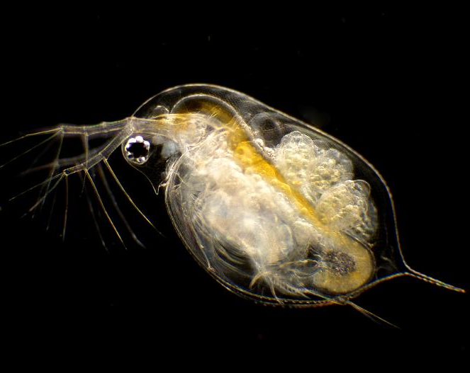
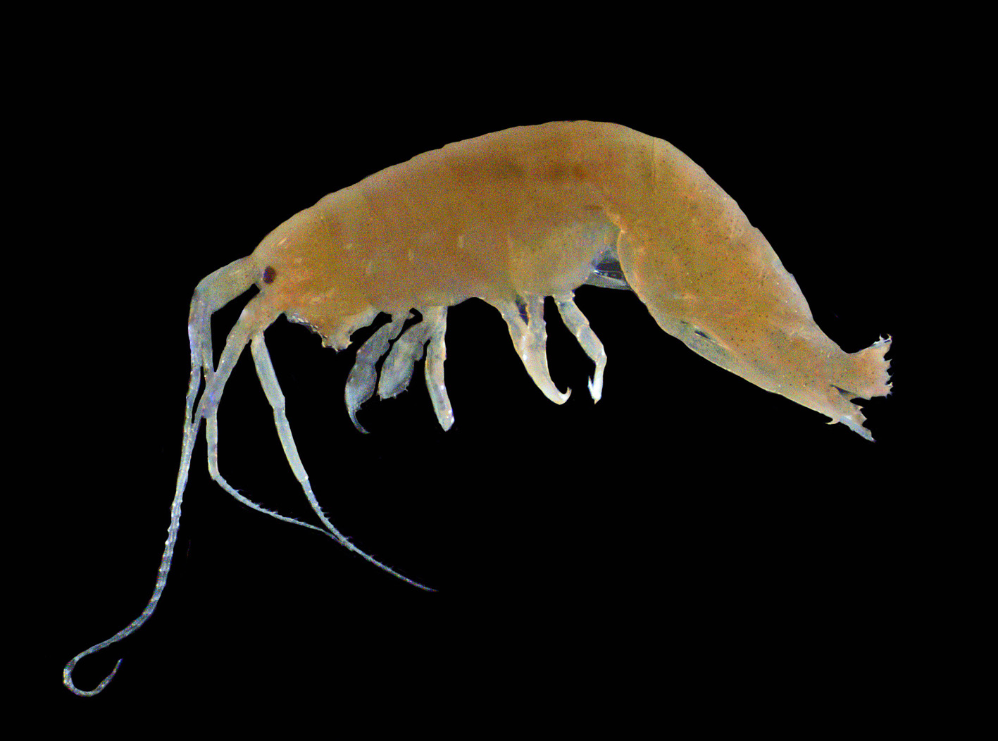
Macroscopic Marine Particulates
Algae
Fecal pellets
Marine snow
Copepods
Daphnia
Amphipods

Slide 14
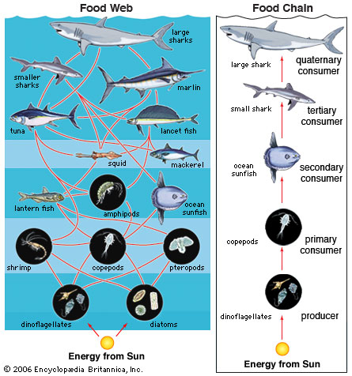
Copepods in the ocean ecosystem

Slide 15
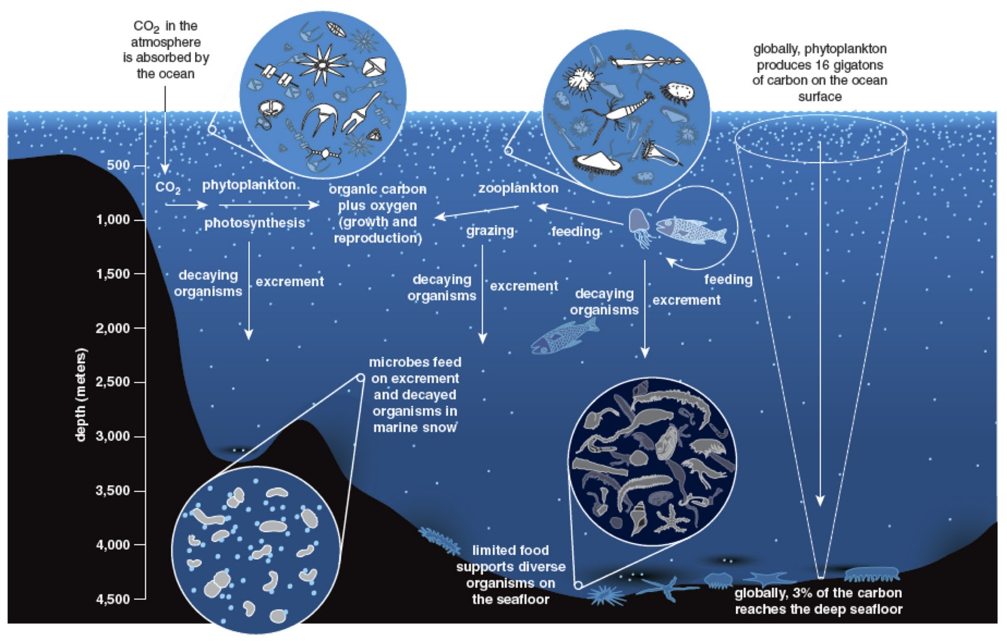
Marine snow and feces in the ocean ecosystem
http://mostlyopenocean.blogspot.com/2012/01/deep-sea-diversity.html

Slide 16
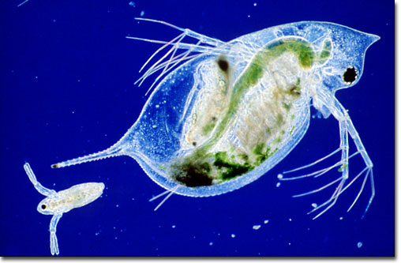
Bioindicators
&
Marine Health

Slide 17
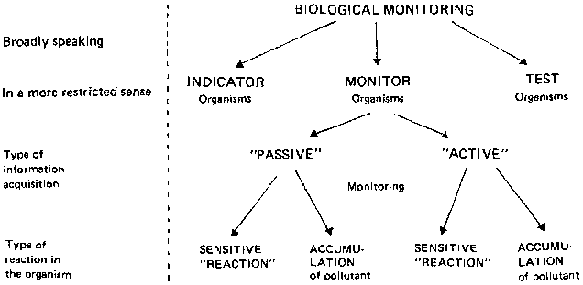
Differentiating Bioindicators
Ellenberg, Hermann, et al. Biological monitoring: signals from the environment. No. 333.95 B615bi. GTZ, Eschborn (Alemania), 1991.

Slide 18
Differentiating Bioindicators
Ellenberg, Hermann, et al. Biological monitoring: signals from the environment. No. 333.95 B615bi. GTZ, Eschborn (Alemania), 1991.

Slide 19
Differentiating Bioindicators
Ellenberg, Hermann, et al. Biological monitoring: signals from the environment. No. 333.95 B615bi. GTZ, Eschborn (Alemania), 1991.

Slide 20
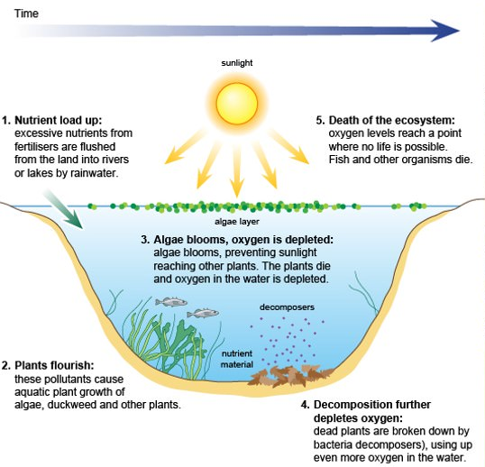
Pollution’s impact on macroscopic marine organisms
Algal blooms

Slide 21
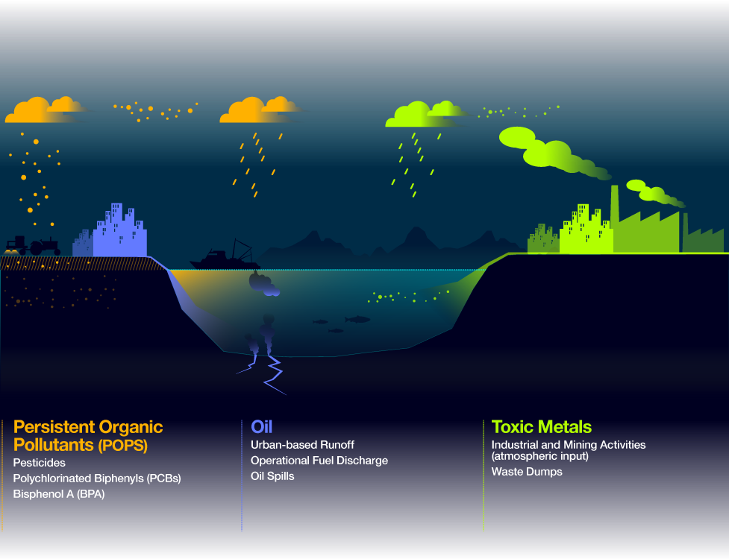
Marine Pollutants
http://www.oceanhealthindex.org/methodology/components/chemical-pollution

